Slide 1
Digital Portfolio
STUDENT NAME:S.NANDHINI
REGISTER NO AND NMID: 24134031802522028
DEPARTMENT: BSC.COMPUTER SCIENCE
COLLEGE: PSPT MGR ARTS AND SCIENCE COLLEGE,PUTHUR

Slide 2
PROJECT TITLE
Data science Project:
A Showcase of My Data Analysis Work
Definition:
This project is a collection of data science analysis case studies that demonstrate the application of data science techniques to extract insights and solve real-world problems.It highlights the complete workflow of data-driven project-including data collection, cleaning, exploration,visualization and statistical or Machine learning modeling-to uncover patterns, support decision-making and present actionable findings.

Slide 3


AGENDA
Problem Statement
Project Overview
End Users
Tools and Technologies
Portfolio design and Layout
Features and Functionality
Results and Screenshots
Conclusion
Github Link
3/21/2024 Annual Review

Slide 4

PROBLEM STATEMENT
Clear define the problem you aimed to solve.
What is the real-world issue or business problem?
Why is it important?
What questions are you trying to answer with data?

Slide 5

PROJECT OVERVIEW
A summary of the project at a glance.
Dataset used (source, size, type).
Scope of work (EDA, modeling, visualization,etc.).
Expected outcomes (predications, insights, recommendations).

Slide 6

WHO ARE THE END USERS?
Define who will benefit from your project.
Target audience (businesses, researchers, customers, policymakers,etc).
How will you insights or solution help them?

Slide 7

TOOLS AND TECHNIQUES
List the technologies you used:
Programming language (Python, R, SQL).
Libraries (Pandas,NumPy,Scikit-learn, Matplotlib, Seaborn,etc.).
Platform (Kaggle, Jupyter, Notebook, Google Colab).
Visualization/Dashboard tools (Tableau, Power, BJ, plotly).

Slide 8
PORTFOLIO DESIGN AND LAYOUT
Explain how you’ve structured your portfolio.
GitHub repository structure (folders, notebooks, README).
Naming Conventions.
Accessibility (easy navigation, documentation).
8

Slide 9
FEATURES AND FUNCTIONALITY
Describe what your project can do.
Key features (data cleaning, prediction, model, dashboard).
Special techniques (ML, pipeline, NLP, time series, clustering).
Any interactive elements (app’s, dashboard,APJs).

Slide 10

RESULTS AND SCREENSHOTS
Present your findings and evidence.
Key insights (graphs, tables, performance metrics).
Model accuracy, error rates.
3/21/2024 Annual Review
10

Slide 11
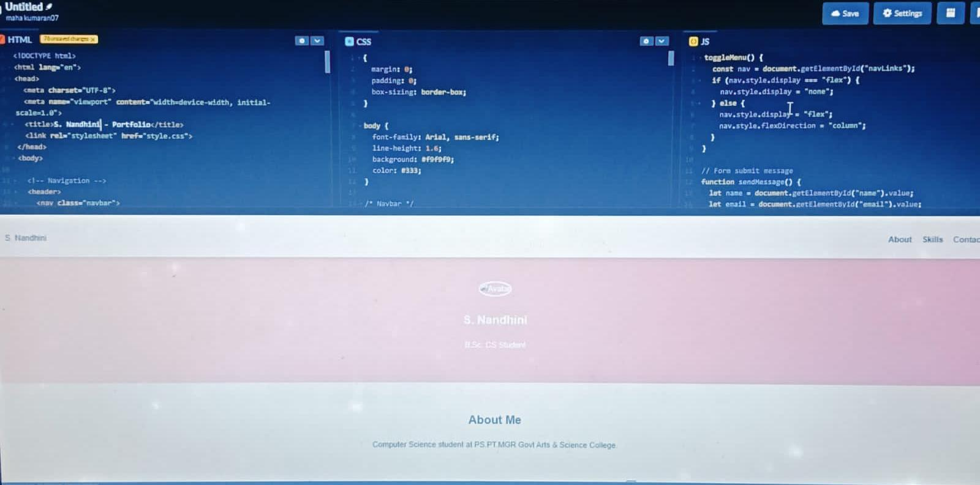
Screen shot

Slide 12
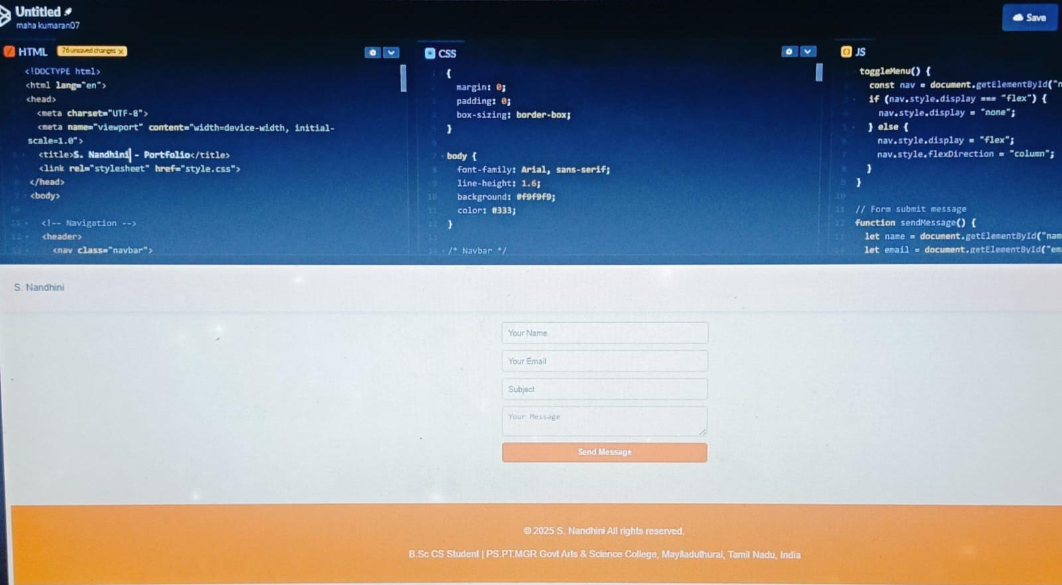
Screen shot

Slide 13
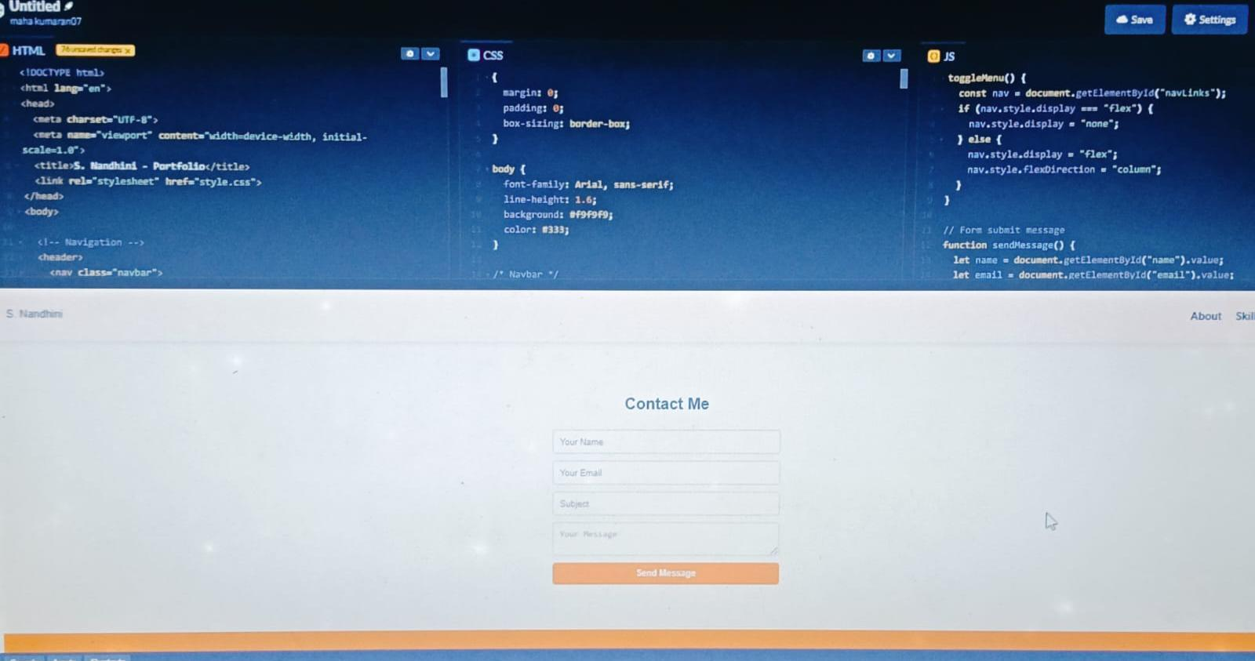
Screen shot

Slide 14
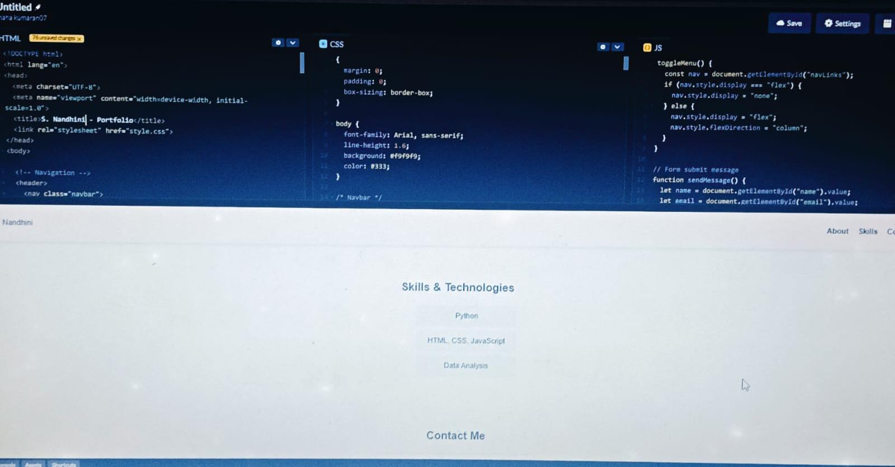
Screen shot

Slide 15
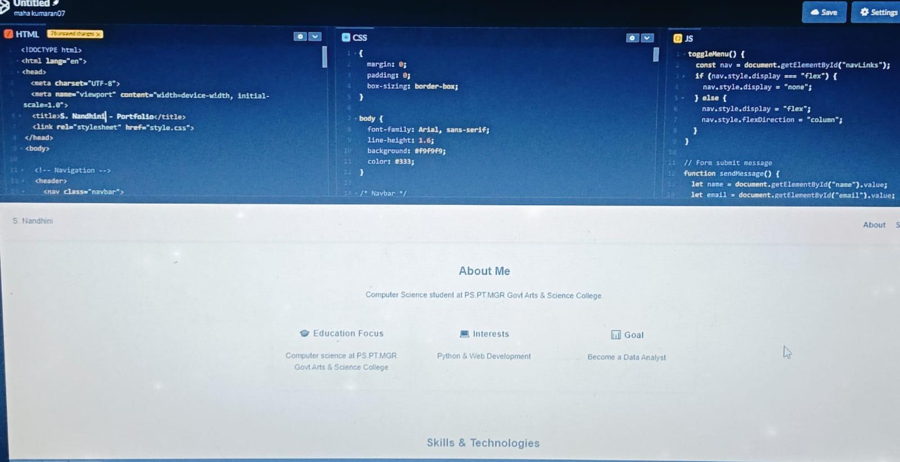
Screen shot

Slide 16
Conclusion
Wrap up with the key takeaways.
Summary of what you achieved.
Limitations of the project.
Future improvement (better models, more data, deployment).

Slide 17
GitHub Link
Provide the direct link to your GitHub repository
for others to explore your code and results

